Slide 1
Hi presenter! Read me before using!
This webinar resource is almost ready for you to use! Be sure to:
Look through and add custom information
Slide 2- Title slide (date)
Slide 3- Presenter information
Slide 5- Housekeeping items
Slide 8- How to find your District’s Brightspace page
Slide 10- Examples of Course Homepages (optional)
Slide 25- Resources (optional)
Slide 27- Thank you slide
There are presenter notes to help guide you- feel free to edit these
This resource can be customized. Here are some examples of how you can personalize this slide deck to suit the needs of your educators and staff:
Replace our images with screen shots from your environment
Read through slides and ensure terms and jargon will resonate with your board policies/ tool names in your Brightspace environment (i.e. Assignments vs Dropbox, Announcements vs News)
Add additional information to slides specific to your district, including how this helps meet district goals, improvements plans, strategic plans etc
Include your district logo on slides or change the colors used to match your district branding

Slide 2
Getting Started with Brightspace
<insert date>
© 2020 D2L Corporation
Notes:
This webinar will cover the basics of setting up your digital classroom in Brightspace. We will look at finding your course(s), setting up and navigating your Homepage, basic customization and using Activity Feed to engage your students.

Slide 3
Presenter Name Title Company/Organization
@Twitter handle

Slide 4
Agenda
What is Brightspace?
District Homepage Navigation
Course Homepage Navigation
Tips for Getting Started and Engaging Learners
Resources
Notes:
Our agenda today covers the key pieces you need to know to begin engaging with the Brightspace platform!
We’ll look at:
What is Brightspace?
How to navigate the District level Homepage
How to navigate your Course Homepage
Tips and tricks to start engaging your students
Provide you resources to use after today’s session

Slide 5
Housekeeping Items
How can people ask questions?
Webinar recording and slide deck will be available on ___________
Information about attendance
Notes:
This slide is for you to add Housekeeping Items particular to your District and this session.
It may include information about how attendees can ask questions, how they can access the webinar information after the session, or even how they confirm their attendance for the session (if applicable)

Slide 6
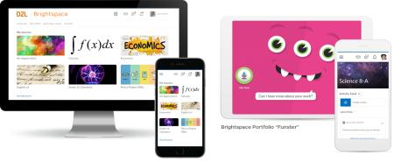
Understanding some terms...
Company:
D2L
Product:
Brightspace
Online Community:
Brightspace Community
Notes:
This is a useful slide to ensure everyone understand the terminology used when discussing Brightspace.
It would be helpful to personalize this slide to include any District specific information, especially if your District as a different branding for “Brightspace.” This will help attendees when they see resources about “Brightspace” to know that this is what your District is using as well but has branded differently.

Slide 7
One platform to collect your teaching resources
Equity for all students
Meaningful connections with students and parents
Why Educators
Brightspace
Tools teachers love
Worry-free technology
Content aligned with curriculum outcomes
Notes:
Here are some reasons Educators love using Brightspace to support their teaching
Tip: Change this up to meet the needs, values and reasons your District loves Brightspace!

Slide 8
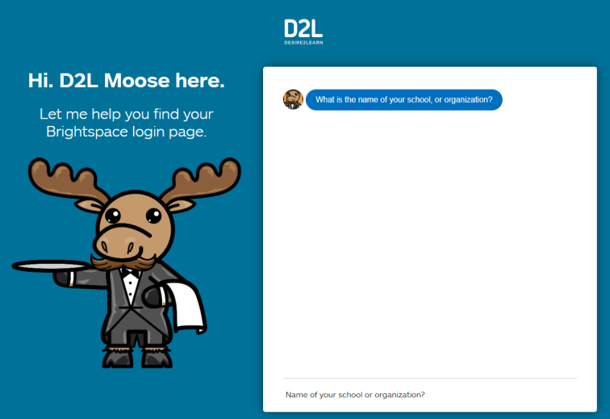
Where’s My District’s Brightspace?
https://login-finder.d2l.com/
Notes:
Use this slide to show how your educators and staff can login into Brightspace. This may include how they long on from their staff portal, what the URL is, and what login in credentials they should use. You may also consider having information for how students can access Brightspace.

Slide 9
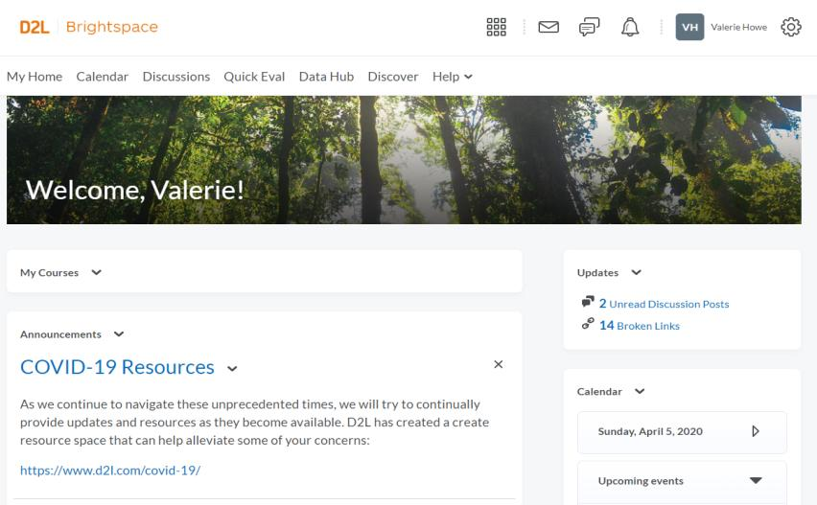
Homepage Overview
Mini-Bar
Navbar
Widgets
Notes:
Before we head into our District environment, I want to take a moment to discuss some useful terminology when navigating Brightspace
Mini-Bar: The mini-bar sits in the upper right-hand corner and is where you will find your Course Selector (also sometimes called “the Waffle,” communication alerts, notifications and updates, and account information and settings
Navbar: Your Navigation Bar (more commonly known as a Navbar) is where you can easily access tools and resources in Brightspace. Your Navbar will change depending on where you are in the system (i.e. your District’s Org Level Homepages vs different Courses)
Widgets: A tech term for something that provides information! There are many different widgets available, and your District may have created their own Widgets as well. The Widgets are the white boxes that you will see on Homepages

Slide 10
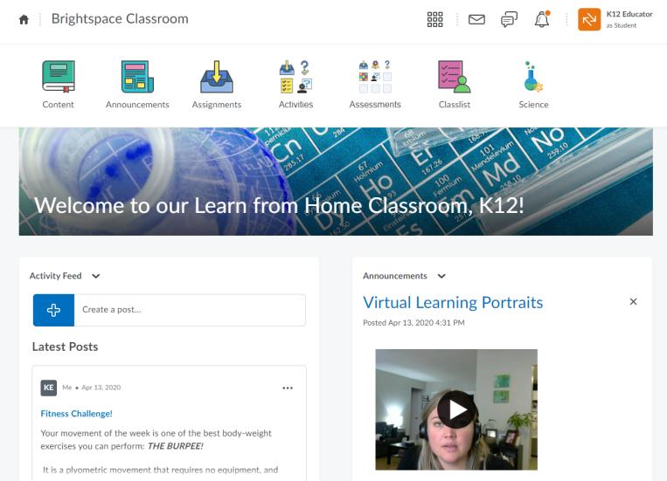
What’s on the Course Homepage?
Return to Homepage
Return to Course Homepage
Nav Bar
1
2
3
4
Waffle
List of all your courses
Email
Chat
Notifications
Notes:
Before we head into our District environment, I want to take a moment to discuss some useful terminology when navigating Brightspace
Mini-Bar: The mini-bar sits in the upper right-hand corner and is where you will find your Course Selector (also sometimes called “the Waffle,” communication alerts, notifications and updates, and account information and settings
Navbar: Your Navigation Bar (more commonly known as a Navbar) is where you can easily access tools and resources in Brightspace. Your Navbar will change depending on where you are in the system (i.e. your District’s Org Level Homepages vs different Courses)
Widgets: A tech term for something that provides information! There are many different widgets available, and your District may have created their own Widgets as well. The Widgets are the white boxes that you will see on Homepages

Slide 11
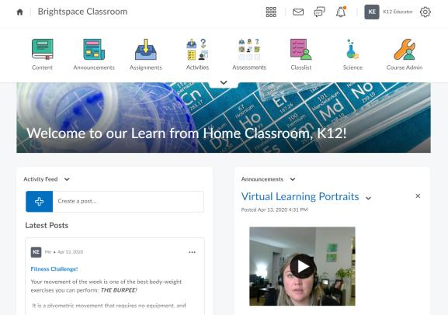
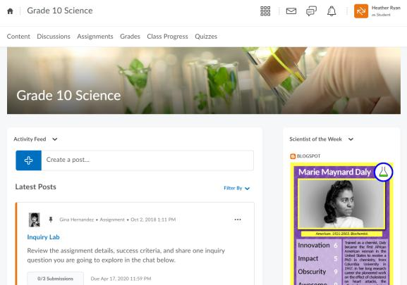
Examples of Course Homepages
** Course homepages may look different depending on how your District has configured Brightspace. **
Notes:
We recommend you personalize this slide to include examples from your own District that will appeal to the demographic of your webinar audience (i.e., Elementary vs Secondary, Science educators vs Second Language educators)
This slide is to highlight that Brightspace is very customizable and different courses might be configured differently or customized to meet the needs of learners for that course

Slide 12
Getting Started in Brightspace:
Homepages
Navbar
Course Banner
Activity Feed
Announcements
Purpose:
Purpose:
Purpose:
Purpose:
Purpose:
The landing page for your District and also in courses. Similar to a bulletin board where you can display useful information and resources for your students
The Navbar is an easy way for you and your students to easily access a wide variety of tools
A space to personalize your course image or display a message or information to students
Interactive tool for educators to share activities on the course homepage
Social media inspired communication tool
Multi-media capable tool to allow teachers to create rich announcements for students that post to the course homepage
Notes:
Use this slide to introduce some of the tools or features you will discuss and cover during the demo
**Be sure to confirm the terminology on this slide matches the language terms used in your District’s Brightspace environment (i.e. Announcements vs News etc)

Slide 13
Getting Started Demo
Learning Objectives:
You will be able to:
Find your courses
Activate courses
Navigate District and Course Homepage
Customize Course Banner
Use Activity Feed
Use Announcements
Notes:
Next we’ll head into a live demo to show you how you can get started with Brightspace
Note: The learning objectives on this slide can be personalized to meet the needs for your District and attendees

Slide 14
Find your course
Notes:
This slide can serve as a resource for your educators & staff after the webinar. It can also serve to help with step by steps instructions if doing a live demo is not possible.
Another option is to let your attendees know these how-to slides are in the slide deck for them to reference, and hide the remaining slides during the live webinar, and unhide them prior to send the slide deck to your attendees after the webinar.

Slide 15
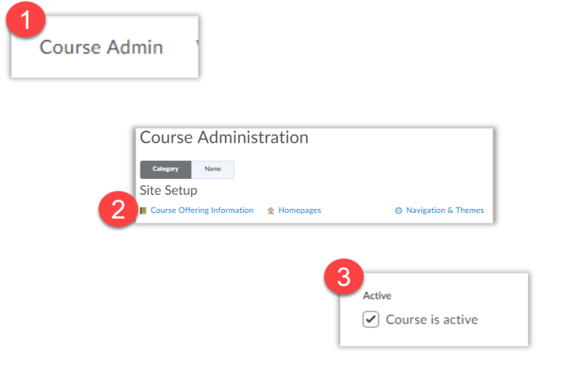
Activating your course
If the course is not active, students will not see any of the content entered/ created. Once active, students can access course content.
Notes:
This slide can serve as a resource for your educators & staff after the webinar. It can also serve to help with step by steps instructions if doing a live demo is not possible.
Another option is to let your attendees know these how-to slides are in the slide deck for them to reference, and hide the remaining slides during the live webinar, and unhide them prior to send the slide deck to your attendees after the webinar.

Slide 16
Customize your Course Banner (1/3)
1
2
Click the ellipsis on the top right of the Course Banner to select your options menu
Choose either “Change Image” or “Customize Banner Text”
Notes:
This slide can serve as a resource for your educators & staff after the webinar. It can also serve to help with step by steps instructions if doing a live demo is not possible.
Another option is to let your attendees know these how-to slides are in the slide deck for them to reference, and hide the remaining slides during the live webinar, and unhide them prior to send the slide deck to your attendees after the webinar.

Slide 17
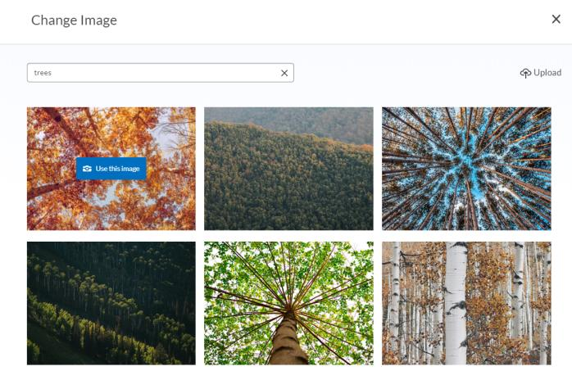
Customize your Course Banner Image (2/3)
1
2
To use an image from our photo library, type in a search term. When you’ve found an image you want to use, place your cursor on the image and click “Use this image”
Have your own image that you’d like to use? Great! Just click the “Upload” option in the top right corner to upload your own image.
Notes:
This slide can serve as a resource for your educators & staff after the webinar. It can also serve to help with step by steps instructions if doing a live demo is not possible.
Another option is to let your attendees know these how-to slides are in the slide deck for them to reference, and hide the remaining slides during the live webinar, and unhide them prior to send the slide deck to your attendees after the webinar.

Slide 18
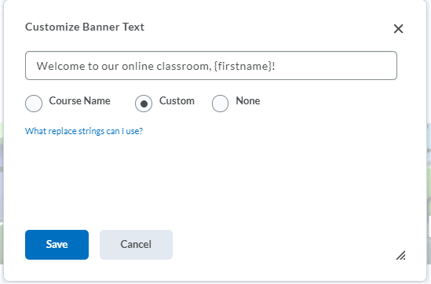
Customize your Course Banner Text (3/3)
1
Tip! Use the replace string {firstname} to personalize the text to include your student’s name! When your student sees the banner, they’ll see their own name instead of {firstname}!
2
By default, your Course Banner will display your course code. To customize your banner text, erase the course code in the text field and type in your own message
Once you’re happy with your message, click “Save.” Voilà! You have a personalized welcome message that you can update and edit at any time!
Notes:
This slide can serve as a resource for your educators & staff after the webinar. It can also serve to help with step by steps instructions if doing a live demo is not possible.
Another option is to let your attendees know these how-to slides are in the slide deck for them to reference, and hide the remaining slides during the live webinar, and unhide them prior to send the slide deck to your attendees after the webinar.

Slide 19
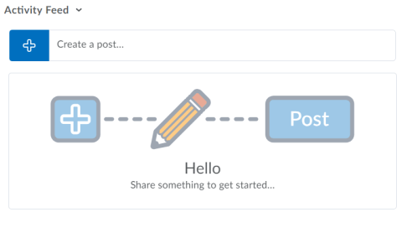
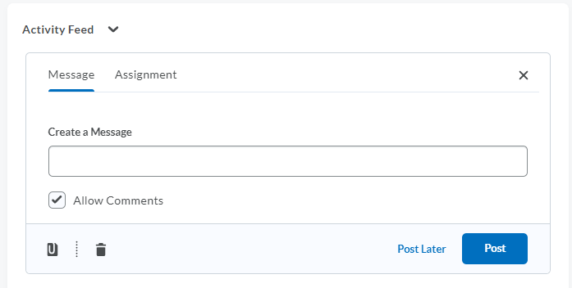
Create a post in Activity Feed! (1/2)
1
2
To get started, click the blue add button to see your posting options
By default, the “Message” option will be selected
Notes:
This slide can serve as a resource for your educators & staff after the webinar. It can also serve to help with step by steps instructions if doing a live demo is not possible.
Another option is to let your attendees know these how-to slides are in the slide deck for them to reference, and hide the remaining slides during the live webinar, and unhide them prior to send the slide deck to your attendees after the webinar.

Slide 20
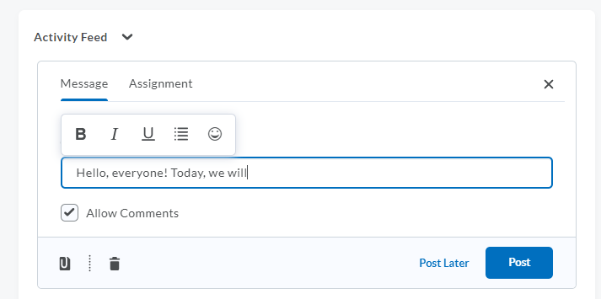
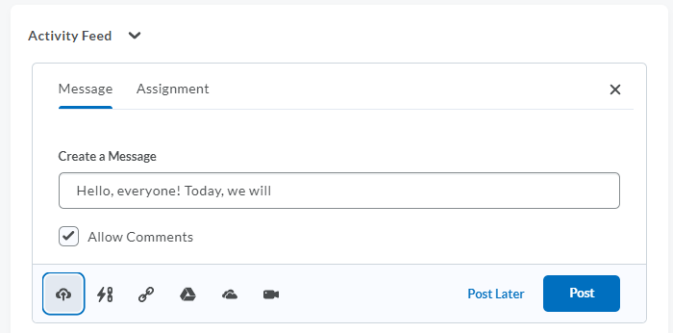
Create a post in Activity Feed! (2/2)
1
2
4
5
3
Click the text field to type your message to your students. Use the editing tools to help format your text or add in emoticons
Choose if students can make comments on the post. They will be able to make comments by default
Click the attachments icon to add additional information to your post
Select what type of attachment you’d like to add (left to right): Upload a file, Link to an Existing Activity in your course, insert a website, attach an item from your Google Drive, attach an item from your OneDrive, attach a video from the web
Schedule your post to post automatically later by clicking “Post Later,” or click “Post” to share your message immediately.
Notes:
This slide can serve as a resource for your educators & staff after the webinar. It can also serve to help with step by steps instructions if doing a live demo is not possible.
Another option is to let your attendees know these how-to slides are in the slide deck for them to reference, and hide the remaining slides during the live webinar, and unhide them prior to send the slide deck to your attendees after the webinar.

Slide 21
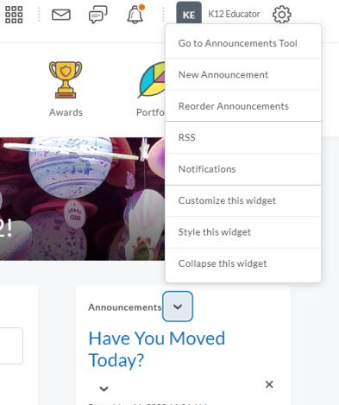
Create a post in Announcements! (1/2)
2
1
Click the down arrow to open the Announcement’s menu
Click “New Announcement”
Notes:
This slide can serve as a resource for your educators & staff after the webinar. It can also serve to help with step by steps instructions if doing a live demo is not possible.
Another option is to let your attendees know these how-to slides are in the slide deck for them to reference, and hide the remaining slides during the live webinar, and unhide them prior to send the slide deck to your attendees after the webinar.

Slide 22
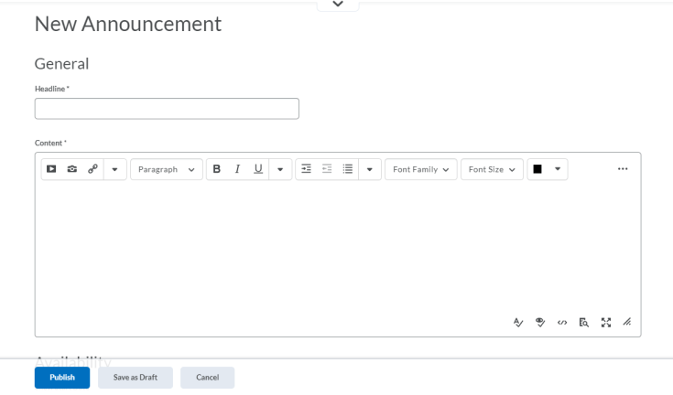
Create a post in Announcements! (2/2)
1
2
3
4
Give your Announcement a Headline/title
This is where you can insert files, add items from your Google Drive, insert a Video Note and more. This is also where you can format and style your written post
Type in your message, information or instructions for your students
Publish your post to share with your students!
Notes:
This slide can serve as a resource for your educators & staff after the webinar. It can also serve to help with step by steps instructions if doing a live demo is not possible.
Another option is to let your attendees know these how-to slides are in the slide deck for them to reference, and hide the remaining slides during the live webinar, and unhide them prior to send the slide deck to your attendees after the webinar.

Slide 23
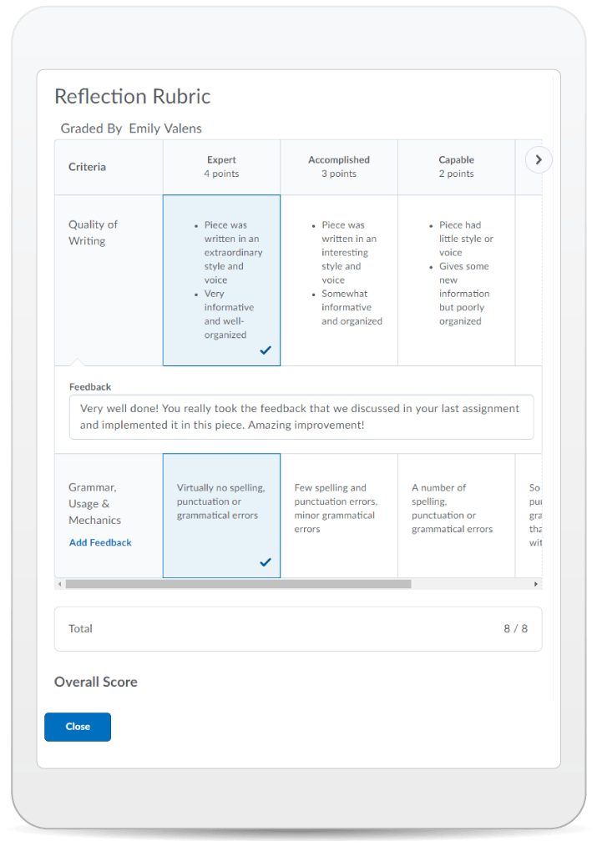
Learning Objectives:
You will be able to:
Find your courses
Activate courses
Navigate District and Course Homepage
Customize Course Banner
Use Activity Feed
Use Announcements
© 2020 D2L Corporation
Notes:
We have achieved all of our learning objectives for this session!

Slide 24
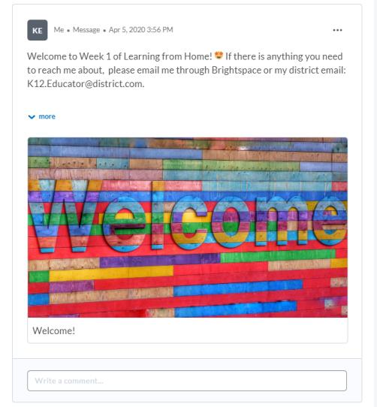
Give This a Try!
Welcome your students to your class by customizing your Course Banner and choose an image from our photo library that reflects your class or subject area!
Create a post in Activity Feed to welcome your students to their online space!
Make a new Announcement for your students- try using Video Note to say a quick hello and welcome your students to Brightspace!
Notes:
Looking on how to get started? Give one of these take away activities a try!

Slide 25
Resources
Brightspace Quick Start Guide K-12
Create an Announcement
D2L Parent and Guardian Support Site
How to Activate a Course
Overview of Activity Feed
Notes:
This page has resources specifically on how to Get Started with Brightspace. This is also where District specific resources can be added.

Slide 26
Tutorial Videos
Communication and Collaboration | Organizing Course Materials | Documenting Student Learning | Feedback & Assessment
Announcements Activity Feed -Add Attachments and Links to Posts -Create an Assignment Post in Activity Feed -Customize Notifications for Activity Feed -For posting a message -Optimize Activity Feed Discussions | Content/Lessons Tool -Getting Started with Lessons for Instructors -Lessons: Add a New Unit and Lesson -Lessons: Add New Materials -Lessons: Reorder Units, Lessons, Folders, and Materials -Lessons: Attach a Release Condition Groups -Creating Groups -Creating Individual Student Groups -Creating Unique Learner Pathways | Brightspace Portfolio -Review and Approve Portfolio Items -Oversee and View Individual Portfolios -Brightspace Portfolio: Bring Your Own Device (for learners) -Portfolio AT HOME Assignments Discussions Quizzes -Quiz Question Converter | Rubrics -Create an Analytic Rubric -Create a Holistic Rubric Grades -Entering Grades -Associate an Activity with a Grade Item -Create a Grade Scheme Standards/Expectations -Standards: Import Standards from Course Admin Assessing or Evaluating Against Expectations Quick Eval
Notes:
There are also many quick tutorial videos available! These resources are organized pedagogically. Every underlined item is linked to a tutorial video

Slide 27
Thank you!
@Twitterhandle
#districthashtag
#D2LK12
Notes:
Thank you so much for joining us today!
If you have any questions or need any help, please consult or contact:
We’d love to see all the awesome ways you’re using Brightspace! Use our District hashtag and/or #D2LK12 so we can all learn from each other and share great ideas of how to use Brightspace to support teaching, learning and, most importantly, our students!

